Slide 1

Purpose of the ETL Tool
Data Source
Data Clean up from both Datasets
New Data Sets
SQL Tables
Conclusion
Project members :
John s. cHAPEK
Donatienne Noel
Claudia Palmer
Alexandra Solano

Slide 2
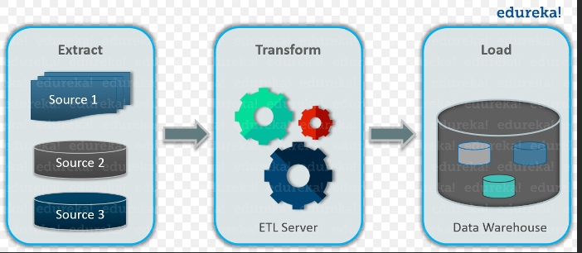
Extraction - Data Source
Our datasets were extracted from two sources:
Kaggle – “Goodreads: Analysis and Recommending Books”
Data-World – "New York Times Bestsellers from 2011-2018”

Slide 3

Transformation - Data Clean up from both Datasets Phase I
To curate our datasets, we took the following approaches:
Removal of unwanted observations from both datasets.
Duplicate observations – usually arise during data collections
Irrelevant observations
Those that didn’t fit the specific solution that we are trying to prove in our research
Fixing Structural errors
Those are Special Characters in the data that was collected. Example: Typos, inconsistent capitalization, and special characters

Slide 4

Transformation - New DataSets – Phase II
Once the data sets were curated, the team proceeded with :
Creating Python codes to view the outputs of our new data sets.

Slide 5
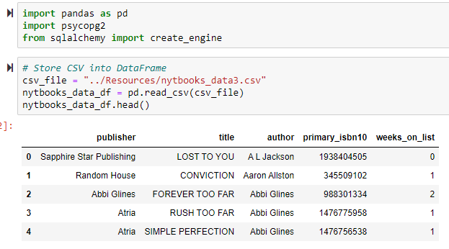
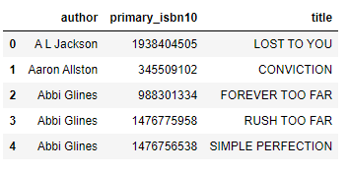
Transformation – Data-World Clean up Results

Slide 6
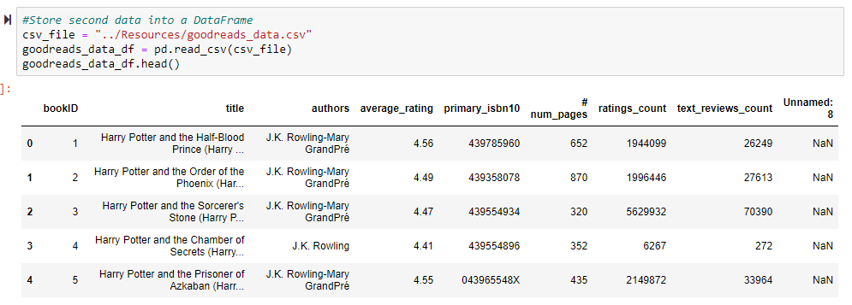
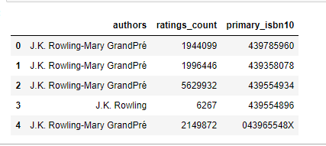
Transformation – Kaggle Clean up Results

Slide 7
Load - SQL Tables -Postgress

Slide 8

When we created the new dataframe from the Goodreads data, we had issues with the columns being offset. We wanted to use isbn10 as a relationship key between the two tables but psycopg2 was having key constraint errors and failing to upload the data to the local database
Constraints - SQL Tables -Postgress
Furthermore, a pandas merge showed that there were no matching ISBNs between the two data frames

Slide 9
Primary / foreign key constraint were removed in postgres. With these constraints accounted for, we loaded data frames into SQL.
Double checking that we don’t have similarities within the dataframe by examining Publisher column and merging by title

Slide 10
The table schema can be seen on the right. We then confirmed that the data was added to the two SQL databases, and performed one last query to verify that it worked. No issues were found.

Slide 11
Conclusion
The purpose of the exercise was to create a successful ETL project.
What we were looking to find using the two datasets selected was to find a way to determine if: (a) the books recommended by Goodreads were in the New York Times Bestseller list, and (b) if the Goodreads average rating and/or rating-count supported it.
When queried, the tables do provide the information elements necessary to meet the objectives above. Therefore, we deemed the ETL effective.

